Slide 1

Artificial Intelligence based Adaptive Fan Speed Control for Residential Energy Efficiency and Optimal Comfort
Presenter :
Hamna Baig
Department of Electrical and Computer Engineering COMSATS University Islamabad Attock Campus
3rd International Conference on Computational Intelligent Systems 2024
Dec 2nd -3rd , 2024 | KUST

Slide 2

OUTLINE
Introduction
Aims and Objectives
Methodology.
Working of the System
Pulse Width Modulation (PWM)
Artificial Intelligence Model Implementation to Control Fan Speed
Results and Discussions
Conclusions
References
3rd International Conference on
Computational Intelligent Systems 2024

Slide 3
INTRODUCTION
Integration of Artificial Intelligence (AI) and Internet of Things (IoT) in smart homes enhances energy efficiency and home comfort [1-5].
AI-driven smart home allows for real-time adjustments based on the environmental conditions [1,4].
The controlling and managing of home appliances can improve home owner quality of life and enhances energy efficiency [3,-8].
In this paper we define the AI-driven fan controlling system that employs machine learning techniques to integrate with environmental sensors data acquisition and controlling on real-time.
3rd International Conference on
Computational Intelligent Systems 2024

Slide 4
AIMS & OBJECTIVES
Dataset Collection
Indoor temperature and corresponding PWM (Pulse Width Modulation) levels to control the speed of fan.
Model Training
Training of Machine Learning algorithms (ML) using the collected dataset.
Model Evaluation
Comparison of Root Mean Squared Error (RMSE) and computational time of each model to select the best one.
Real-Time Prediction
Use the best model to predict PWM levels for controlling fan speed on basis of real-time measured indoor temperature.
3rd International Conference on
Computational Intelligent Systems 2024

Slide 5
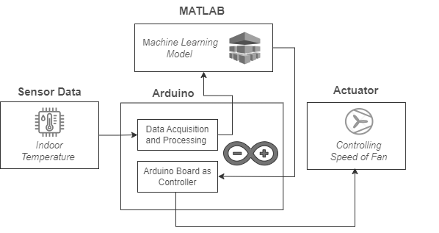
METHODOLOGY
This system is basically designed to be used in residential settings, offices or other buildings to contribute in enhancing human comfort and energy efficiency by controlling speed of fan to the desired levels.
The system block diagram is shown in Fig. (1).
Fig. (1) : System Block Diagram
3rd International Conference on
Computational Intelligent Systems 2024

Slide 6
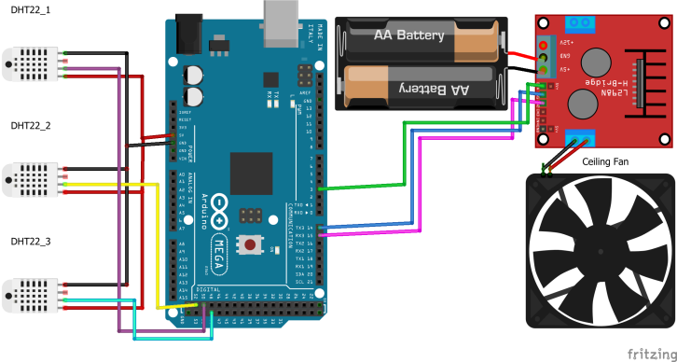
METHODOLOGY - WORKING OF THE SYSTEM
The circuit diagram is shown in Fig. 2 and the sensors are placed strategically in a prototype wooden house, avoiding direct heat and moisture, to ensure accurate temperature measurements.
Input
Output
Fig. (2) : Circuit Diagram
3rd International Conference on
Computational Intelligent Systems 2024

Slide 7
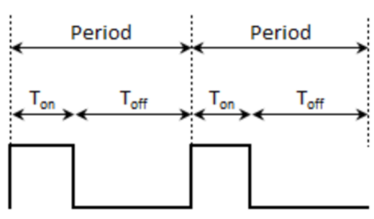
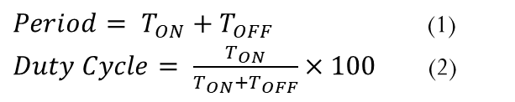
METHODOLOGY – PULSE WIDTH MODULATION
PWM (Pulse Width Modulation) technique on Arduino adjusts fan speed by varying voltage (0-5V) on specific PWM pins, regulated by a dedicated control circuit based on environmental conditions.
The temperature and corresponding fan speed and PWM is given in the dataset taking below as a reference from paper [9-10].
The varying 0-5 V signal at pin 10 of Arduino Mega 2560 is given to motor driver L298n for controlling speed of fan on basis of PWM.
Temperature (Celsius) | Fan Speed (Percentage) | PWM | Voltage
T<20 | 0 | 0 | 0 V
20<T<22 | 30 | 77 | 1.5V
22<T<24 | 50 | 128 | 2.5V
24<T<26 | 70 | 179 | 3.5V
26<T<28 | 90 | 231 | 4.5V
T>28 | 100 | 255 | 5V
$Period= T_{ON}+T_{OFF}$ (1)
$Duty Cycle= \frac{T_{ON}}{T_{ON}+T_{OFF}}×100$ (2)
3rd International Conference on
Computational Intelligent Systems 2024

Slide 8
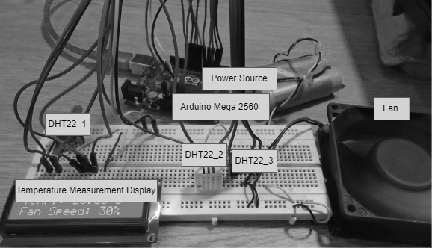
METHODOLOGY – DATASET FOR TRAINING MACHINE LEARNING ALGORITHMS
The DHT22 sensor operates at a 0.25 Hz sampling rate, providing synchronized data capture with 900 training examples per hour is collected through the experimental setup shown in Fig. 4.
Fig. 4. Experimental Setup to Collect Dataset
3rd International Conference on
Computational Intelligent Systems 2024

Slide 9
METHODOLOGY – DATASET FOR TRAINING MACHINE LEARNING ALGORITHMS
The collected values were stored in excel file in .csv format for model training, correlating indoor temperature with PWM and fan speed decisions as shown in Table II.
TABLE II : Dataset for Training Machine Learning Models
N | Indoor Temperature (◦C) | PWM Level | Fan Speed
1 | 21.2 | 77 | 30
2 | 22.5 | 128 | 50
3 | 23.1 | 128 | 50
4 | 24.8 | 179 | 70
5 | 25.6 | 179 | 70
6 | 28.9 | 255 | 100
: | ; | ; | ;
10000 | 35.5 | 0 | 0
3rd International Conference on
Computational Intelligent Systems 2024

Slide 10
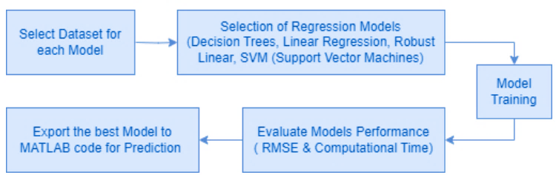
ARTIFICIAL INTELLIGENCE MODEL IMPLEMENTATION TO CONTROL FAN SPEED
Fig. 5. Steps to Build AI Model in Regression Learner to Predict PWM (Pulse Width Modulation) to control Fan Speed
3rd International Conference on
Computational Intelligent Systems 2024

Slide 11
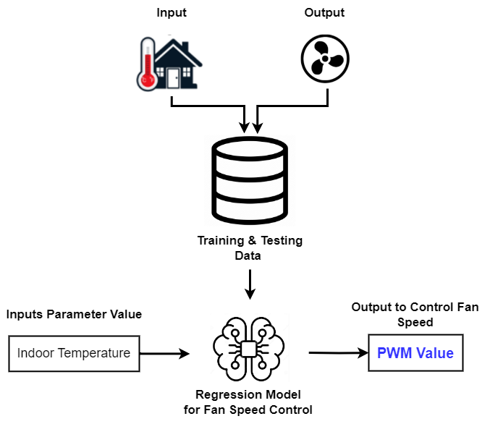
ARTIFICIAL INTELLIGENCE MODEL IMPLEMENTATION TO CONTROL FAN SPEED
Fig. 6. Regression Model to Predict PWM
3rd International Conference on
Computational Intelligent Systems 2024

Slide 12
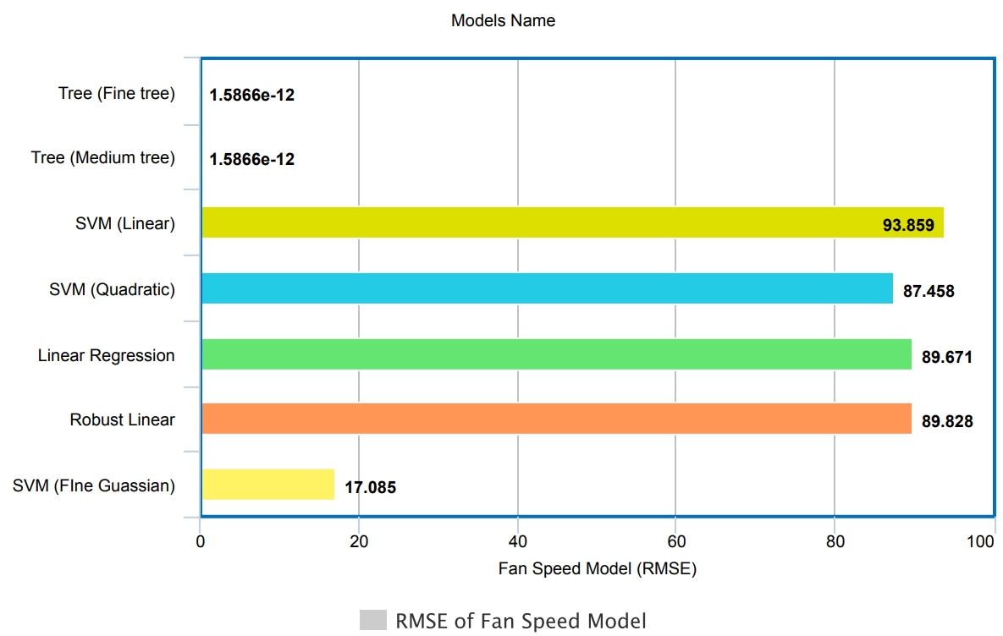
RESULTS & DISCUSSION
Trained Models for Fan Speed : For the fan speed control the model that gives the least Root Mean Squared error is medium tree.
RMSE = 1.5866 e-12
Computational Time=54.61 s
So we import the Medium Tree model for the prediction of PWM to control fan speed.
Fig. 7. All Trained Regression Models RMSE Values for PWM Prediction
3rd International Conference on
Computational Intelligent Systems 2024

Slide 13
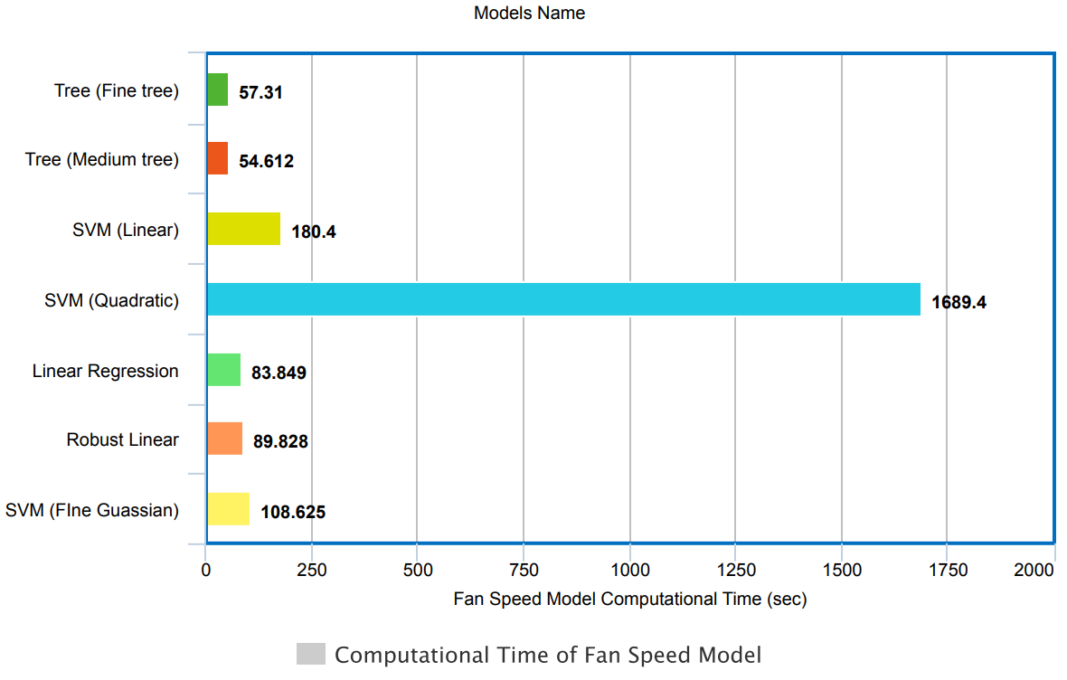
RESULTS & DISCUSSION
Fig. 8.
3rd International Conference on
Computational Intelligent Systems 2024

Slide 14
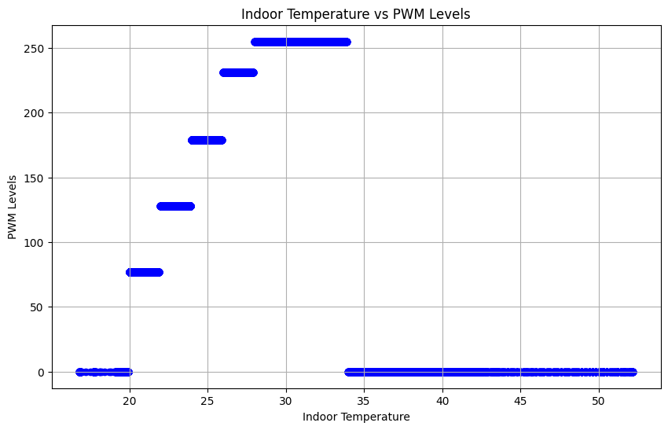
RESULTS & DISCUSSION
Fig.9. Scatter Plot for Trained Medium Tree Model of Fan Speed Control
3rd International Conference on
Computational Intelligent Systems 2024

Slide 15
RESULTS & DISCUSSION
TABLE III : Predicted and ACtual Value of PWM on basis of Indoor Temperature
Indoor Temperature (Test data) | Actual PWM | Predicted PWM
14 | 0 | 0
34 | 0 | 0
29 | 255 | 255
22 | 77 | 77
26 | 179 | 179
23 | 128 | 128
42 | 0 | 0
55 | 0 | 0
18 | 77 | 77
3rd International Conference on
Computational Intelligent Systems 2024

Slide 16
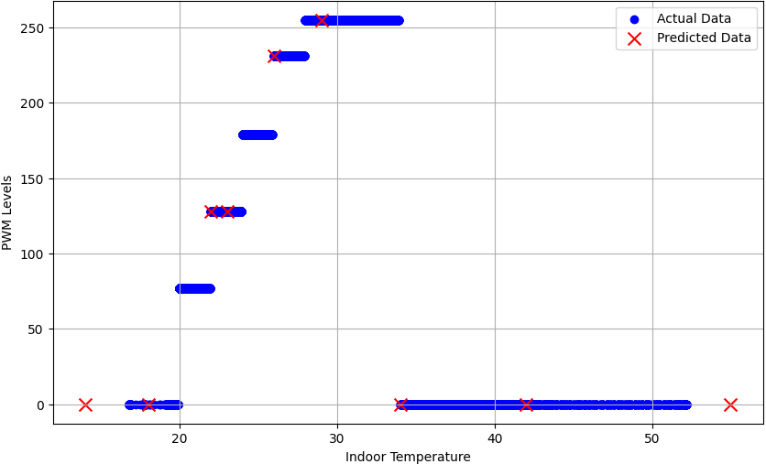
RESULTS & DISCUSSION
Fig.10. Plot of AI Model Predicted and Actual Dataset Value of PWM
3rd International Conference on
Computational Intelligent Systems 2024

Slide 17
CONCLUSION & FUTURE WORK
To enhance human comfort, smart home technology using machine learning algorithm is best and easy way.
Fan speed is controlled on basis of PWM which is predicted on the basis of temperature using Decision Tree Regression as it gives lowest RMSE for the scenario.
In future, it is recommended that fan speed controlling in residential settings using machine learning will enhance energy efficiency and more home appliance can be controlled by expanding the system.
IoT (Internet of Things) can be included in the system for its advancements to enhance user preferences.
3rd International Conference on
Computational Intelligent Systems 2024

Slide 18
REFERENCES
[1]. O. Taiwo and A. E. Ezugwu, ―Internet of things-based intelligent smart home control system,‖ Security and Communication Networks, vol. 2021, pp. 1–17, 2021.
[2] A. Almusaed, I. Yitmen, and A. Almssad, ―Enhancing smart home design with ai models: A case study of living spaces implementation review,‖ Energies, vol. 16, no. 6, p. 2636, 2023.
[3] Alam, M. R., Reaz, M. B. I., & Ali, M. A. M. (2012). A review of smart homes—Past, present, and future. IEEE transactions on systems, man, and cybernetics, part C (applications and reviews), 42(6), 1190-1203.
[4] B. Dzogovic, B. Santos, J. Noll, B. Feng, T. Van Do, et al., ―Enabling smart home with 5g network slicing,‖ in 2019 IEEE 4th International Conference on Computer and Communication Systems (ICCCS), pp. 543–548, IEEE, 2019.
[5] Machorro-Cano, I., Alor-Hernández, G., Paredes-Valverde, M. A., Rodríguez-Mazahua, L., Sánchez-Cervantes, J. L., & OlmedoAguirre, J. O. (2020). HEMS-IoT: A big data and machine learningbased smart home system for energy saving. Energies, 13(5), 1097.
[6] K.-C. Yao, W.-T. Huang, C.-C. Wu, and T.-Y. Chen, ―Establishing an ai model on data sensing and prediction for smart home environment control based on labview,‖ Mathematical Problems in Engineering, vol. 2021, pp. 1–18, 2021.
[7] Salhi, L., Silverston, T., Yamazaki, T., & Miyoshi, T. (2019, January). Early detection system for gas leakage and fire in smart home using machine learning. In 2019 IEEE International Conference on Consumer Electronics (ICCE) (pp. 1-6). IEEE.
[8] Casaccia, S., Romeo, L., Calvaresi, A., Morresi, N., Monteriu, A., Frontoni, E., ... & Revel, G. M. (2020). Measurement of users’ wellbeing through domotic sensors and machine learning algorithms. IEEE Sensors Journal, 20(14), 8029-8038.
3rd International Conference on
Computational Intelligent Systems 2024

Slide 19

Thank you for your attention!
Questions/ Queries/ Suggestions and Recommendation are appreciated!
3rd International Conference on
Computational Intelligent Systems 2024

